Slide 1
National Cancer Statistics in Korea, 2015
2017. 12. 21.
Korea Central Cancer Registry

Slide 2
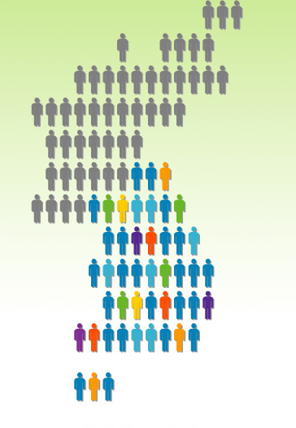
Cancer Incidence in Korea, 2015

Slide 3
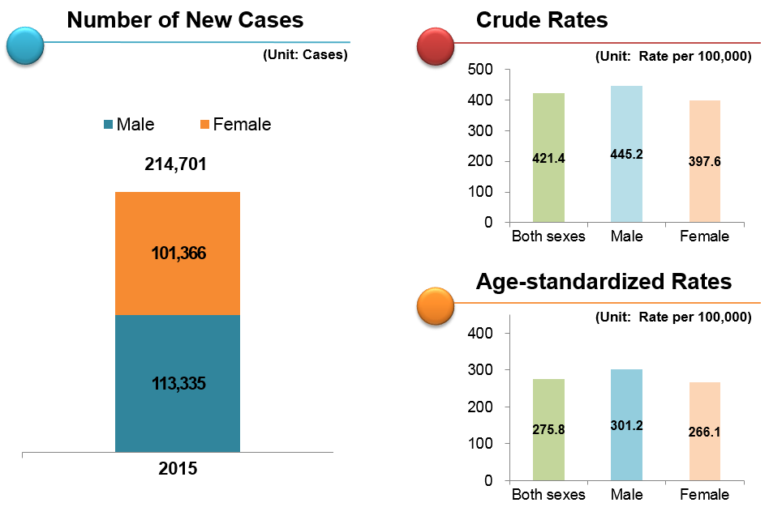
National Cancer Incidence, 2015

Slide 4
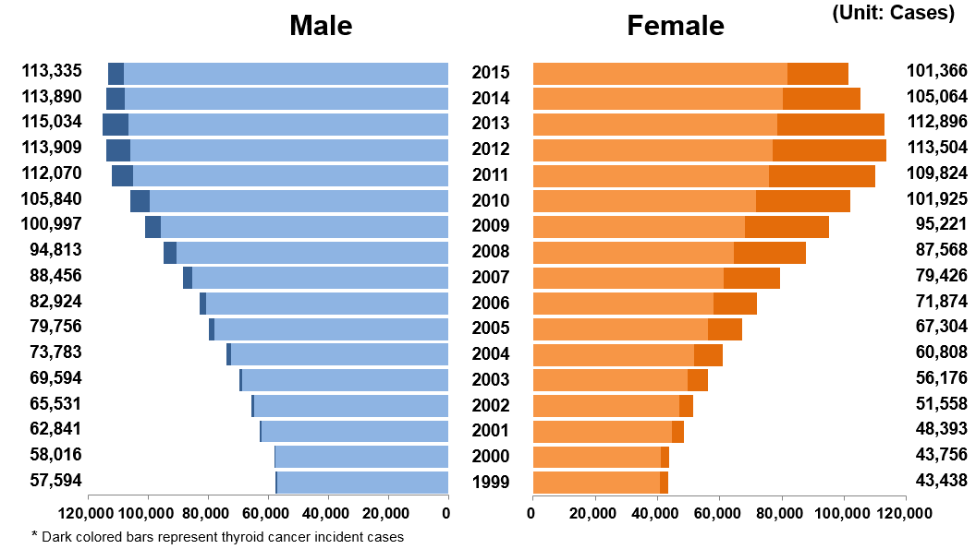
Trends in Cancer Incidence by Sex, Year

Slide 5
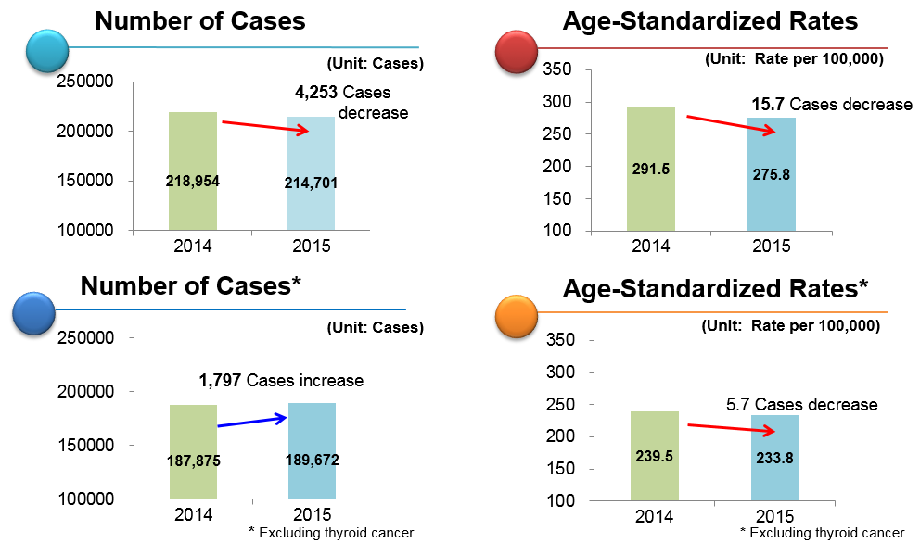
Comparison of cancer cases and rates between 2014 and 2015
Notes:
.

Slide 6
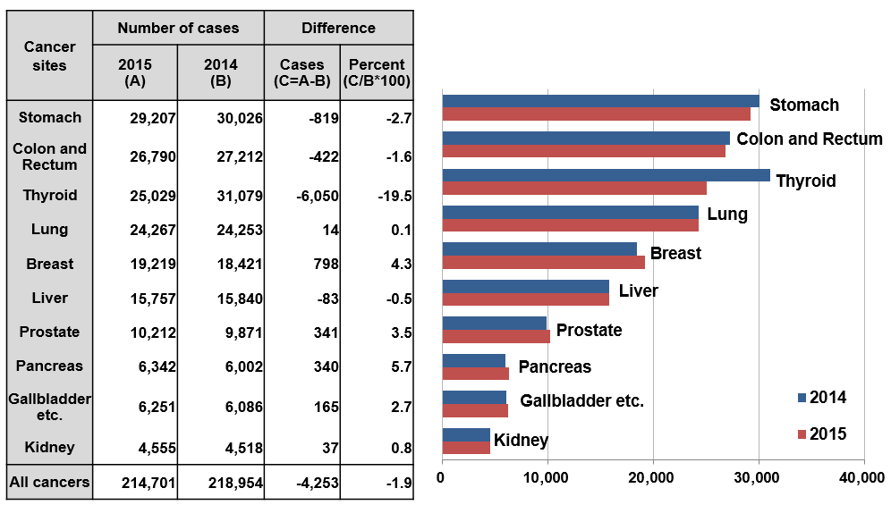
Number of cases by cancer sites (2014-2015)

Slide 7
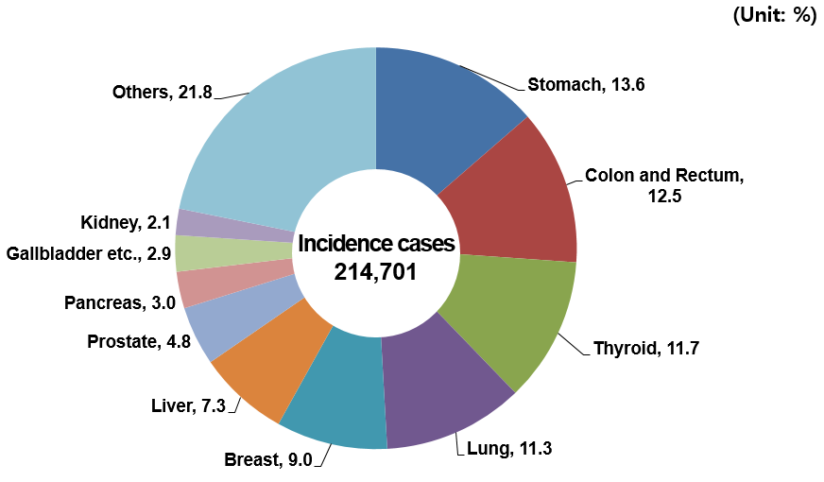
Distribution by Cancer Sites, 2015

Slide 8
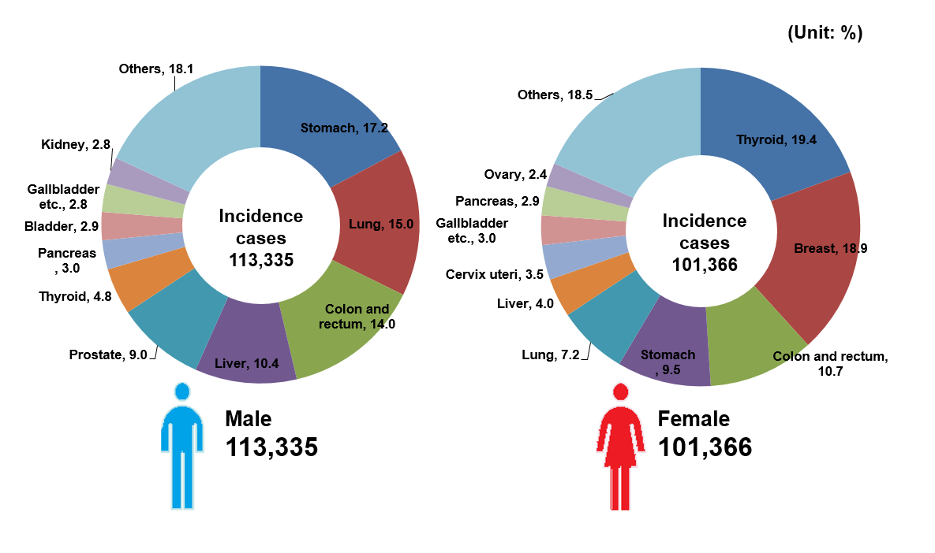
Distribution by Cancer Sites and Sex, 2015

Slide 9
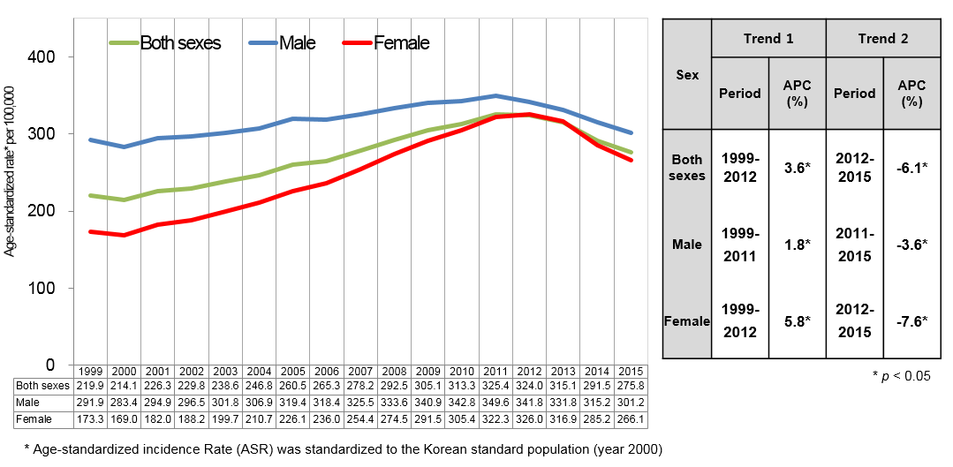
Trends in Age-standardized Incidence Rate:
All cancer Sites, 1999-2015

Slide 10
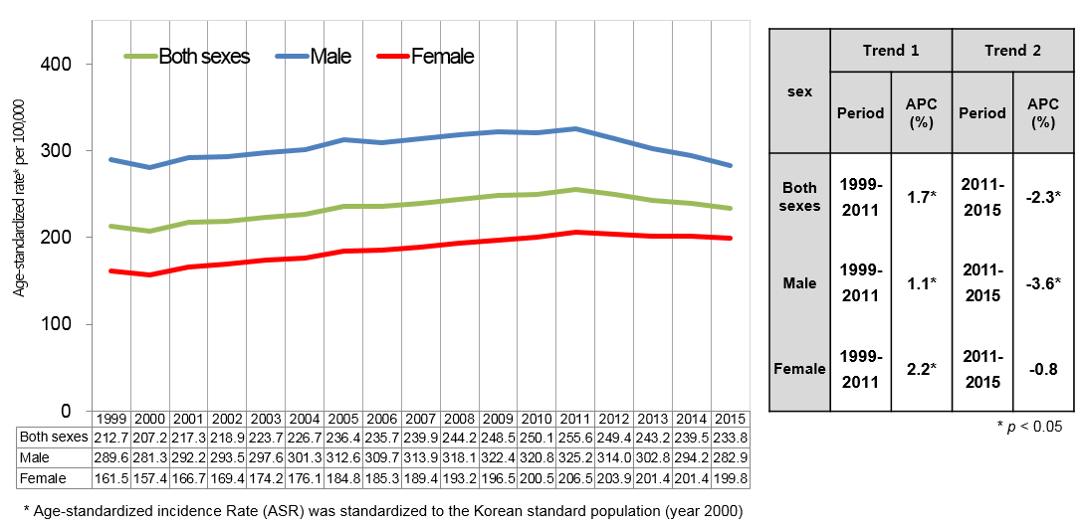
Trends in Age-standardized Incidence Rate:
Excluding Thyroid, 1999-2015

Slide 11
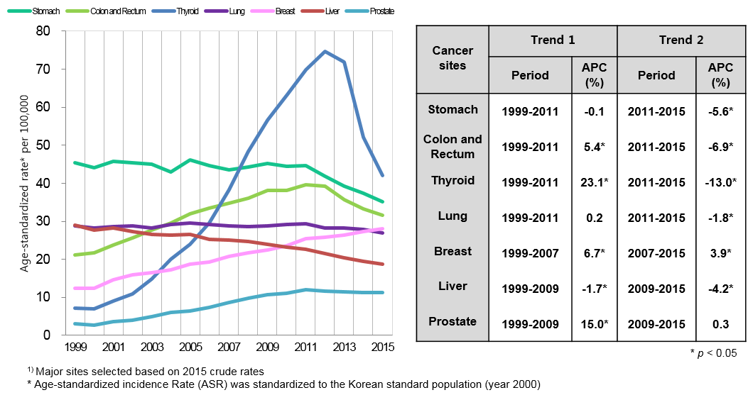
Trends in Major Cancers¹⁾:
Both sexes, 1999-2015

Slide 12
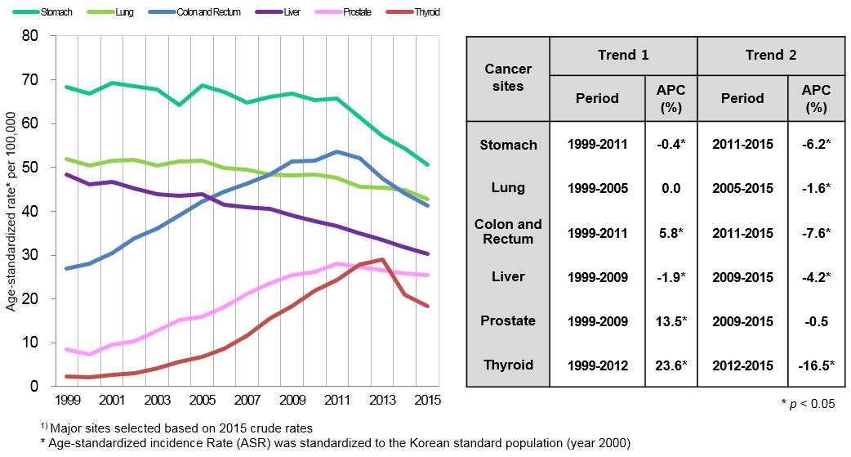
Trends in Major Cancers¹⁾:
Male, 1999-2015

Slide 13
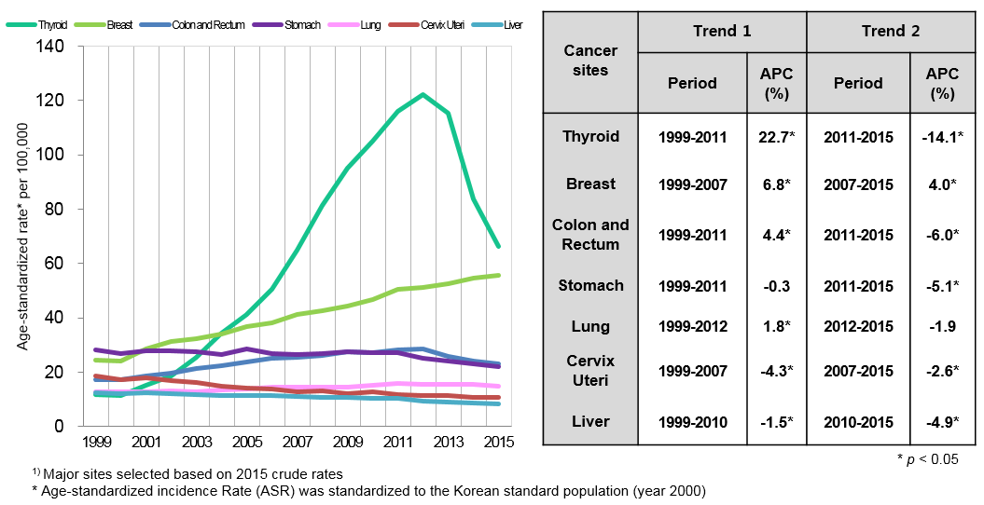
Trends in Major Cancers¹⁾:
Female, 1999-2015

Slide 14
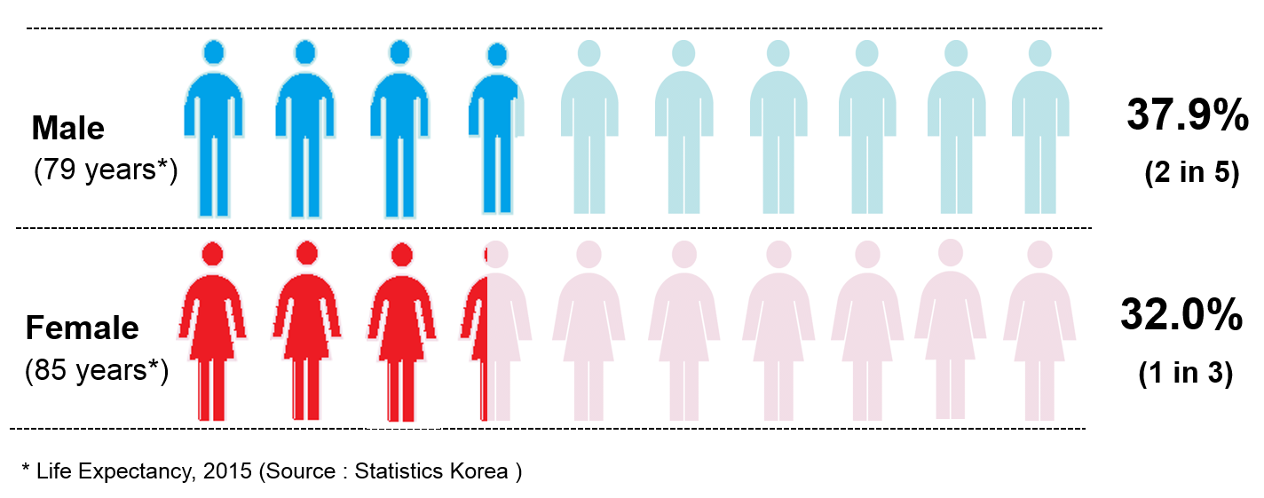
Cumulative Risk of Cancer in Korea, 2015

Slide 15
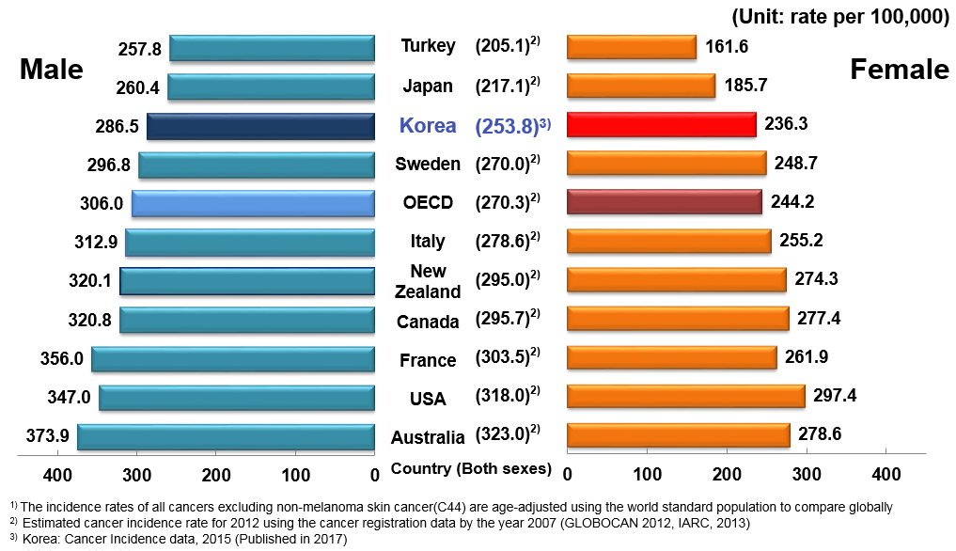
International Comparison of
Age-standardized Incidence Rates¹⁾ by Sex

Slide 16
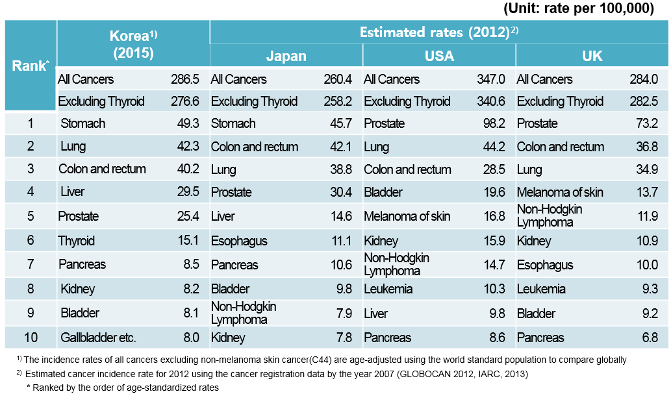
International Comparison of
Age-standardized Incidence Rates : Male

Slide 17
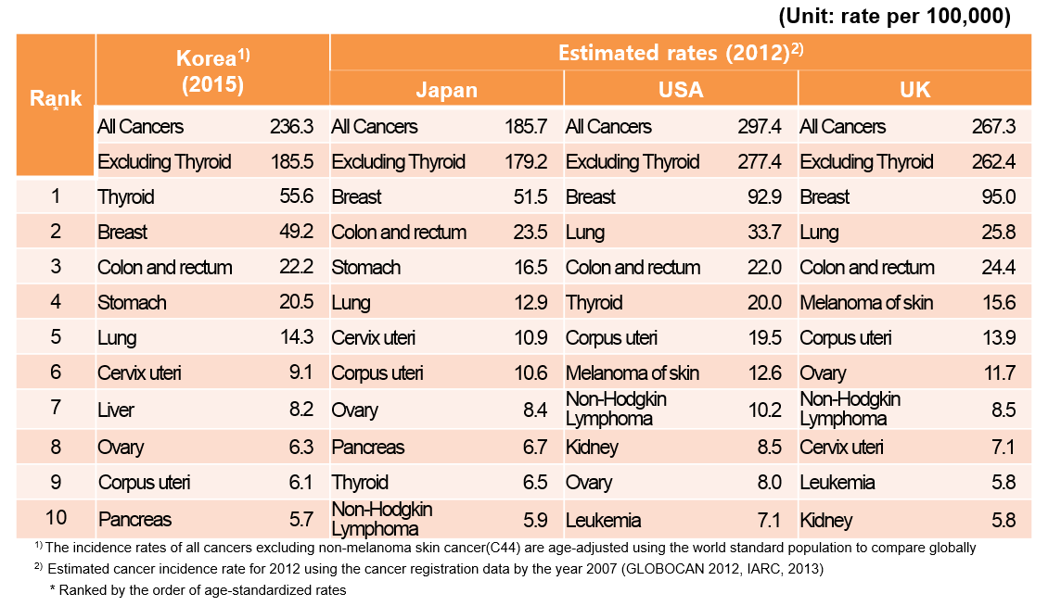
International Comparison of
Age-standardized Incidence Rates: Female

Slide 18

Cancer Survival in Korea, 2015

Slide 19
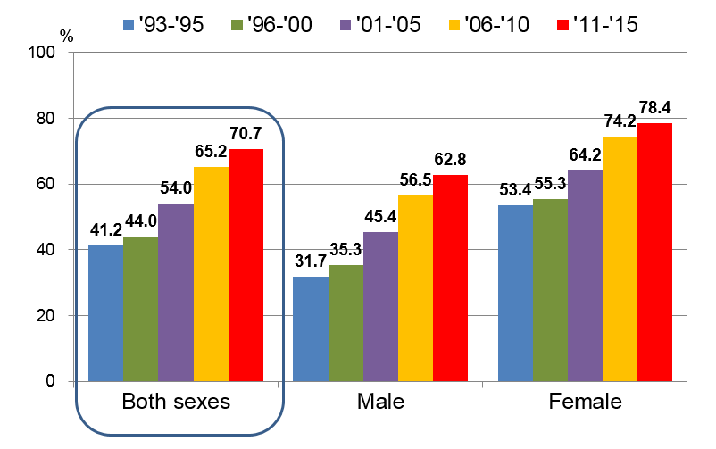
Trends in Five-year Relative Survival by Sex:
All cancers

Slide 20
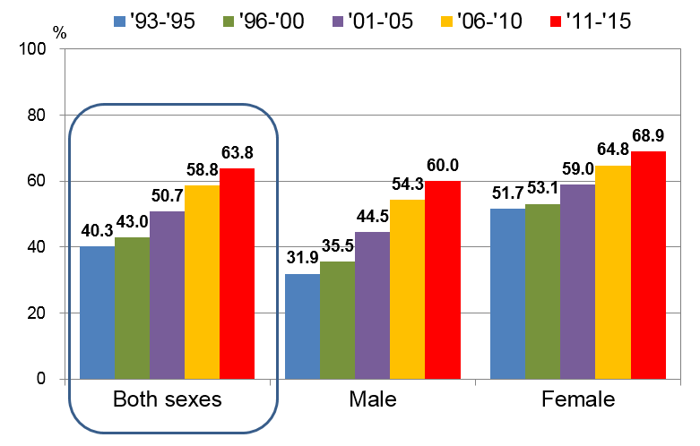
Trends in Five-year Relative Survival by Sex:
Excluding Thyroid

Slide 21
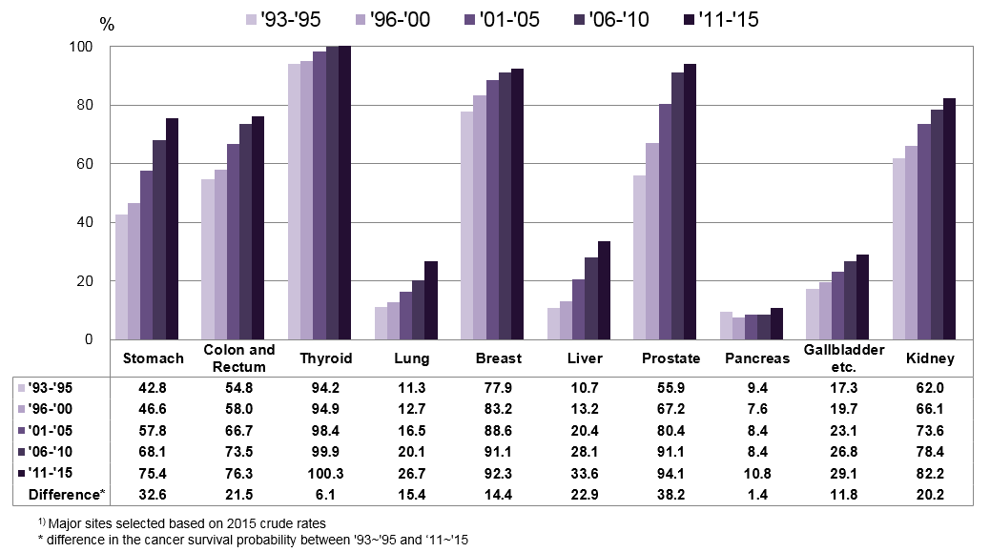
Five-year Survival of Major Cancer Sites¹⁾: Both sexes

Slide 22
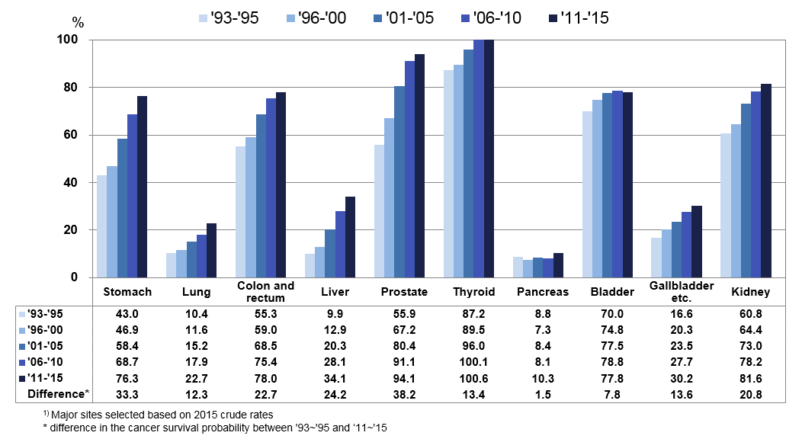
Five-year Survival of Major Cancer Sites¹⁾: Male

Slide 23
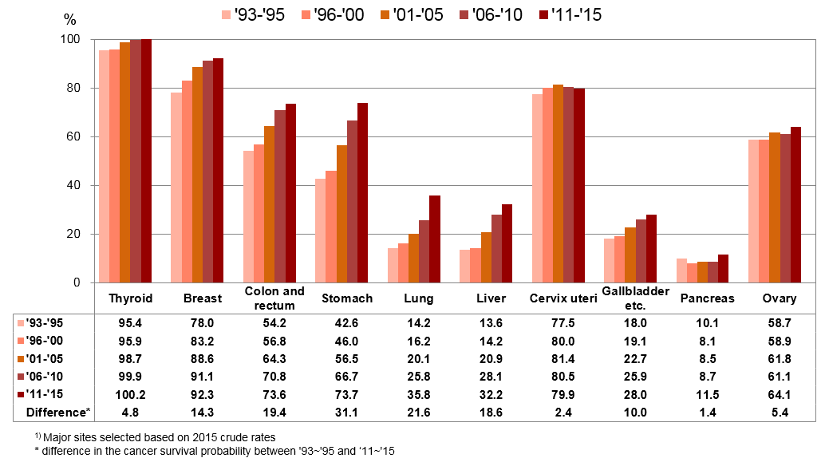
Five-year Survival of Major Cancer Sites¹⁾: Female

Slide 24
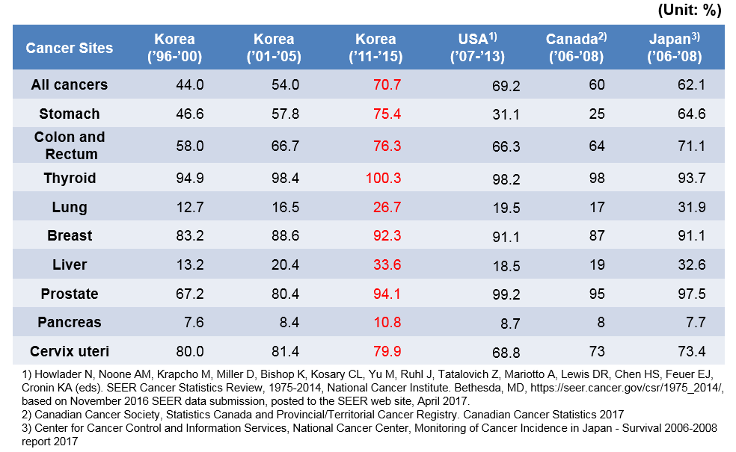
International Comparison of
Five-year Relative Survival

Slide 25
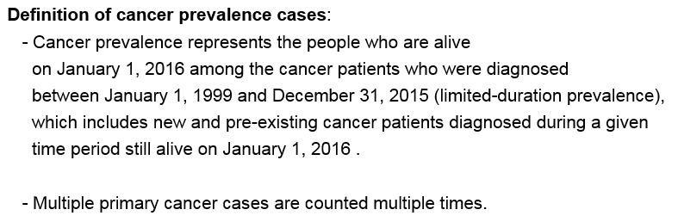
Cancer Prevalence in Korea, 2015

Slide 26
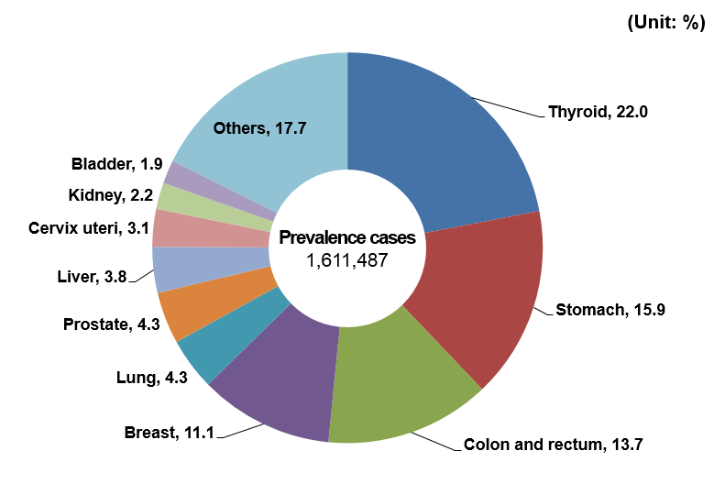
Distribution of Cancer Prevalence, 2015

Slide 27
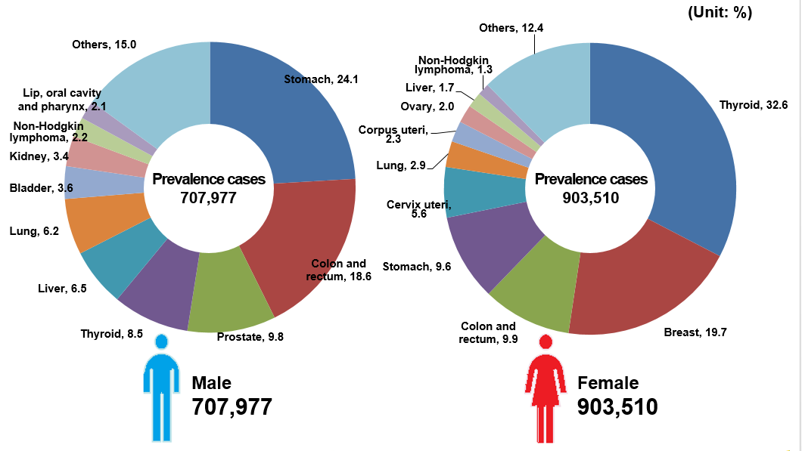
Distribution of Cancer Prevalence by Sex, 2015

Slide 28
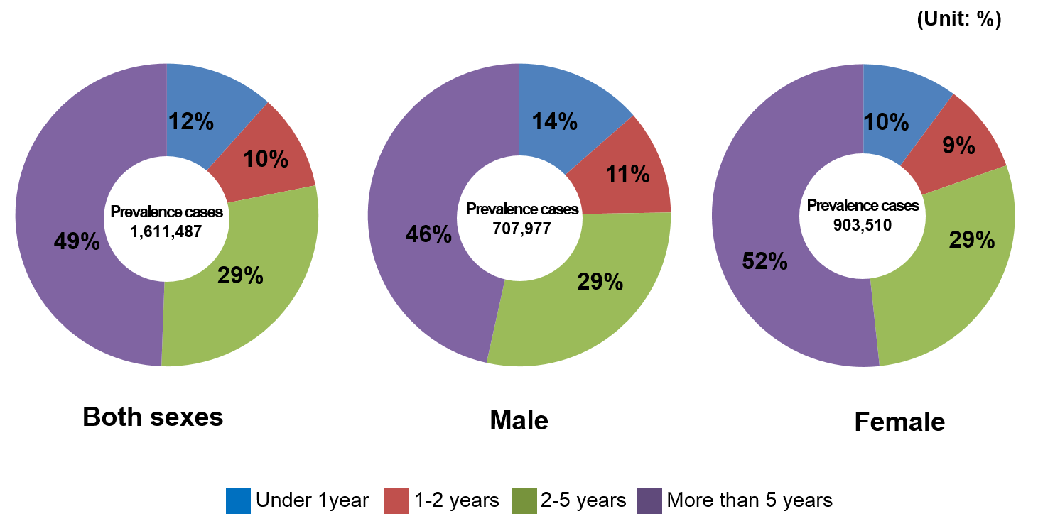
Prevalence of All Cancers by Time since Diagnosis*, 2015
* People who are alive on January 1, 2016 among the cancer patients who were diagnosed between January 1, 1999 and December 31, 2015

Slide 29
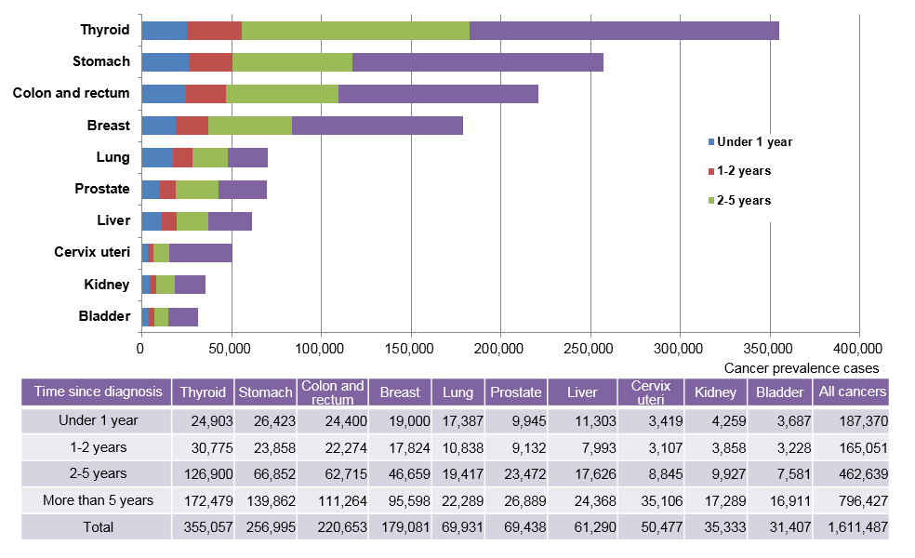
Prevalence of Major Cancer Sites by Time since Diagnosis, 2015

Slide 30

Thank you

